Slide 1

Presentation on : ONLINE TEST
Presented by:
Achal shah
Sarena Dawadi
Rabin ale
Basanta Pokhrel
Roll no: 2, 21, 17, 3
Semester: Fifth Semester
Subject: Software Engineering
Guided by
Ghan Bhadur Thapa sir
College of IT , Aadikavi bhanubhakta campus

Slide 2

Content
Introduction
Objectives
Work Division
Tools
Time Schedules
Demonstrates
Conclusion

Slide 3

Introduction
Online Exams is being launched because a need for a destination that is beneficial for both institutes and students. With this site, institutes can register and host online exams. Students can give exams and view their results. This site is an attempt to remove the existing flaws in the manual system of conducting exams.
Purpose
Online Exams System fulfills the requirements of the institutes to conduct the exams online. They do not have to go to any software developer to make a separate site for being able to conduct exams online. They just have to register on the site and enter the exam details and the lists of the students which can appear in the exam. Students can give exam without the need of going to any physical destination. They can view the result at the same time. Thus the purpose of the site is to provide a system that saves the efforts and time of both the institutes and the students..

Slide 4
Objective
1. General objective
General objective of our project is to change the current manual system into computerized one. This project would be very useful for educational institutes where regular evaluation of students is required.
2. Specific objective
Online examination project assesses student by conducting online objective tests.
Responses by the candidates will be checked automatically.
It reduces time consumption.
Being an integrated online examination system reduce paper work.
Questions can have multiple options, multiple answers or can be text answers.

Slide 5
Continue….
To allow department to create tests and answers.
The result will be shown after some time to the participating students.
Can generate various report for evaluation purpose when and where required.
This project will enable educational institutes to conduct test and have automated checking of answers based on the response by the candidates.
It would enable educational institutes to perform testes quiz and create feedback forms.

Slide 6
Work division
SN | Activities | Participates
1 | Requirement | Rabin ,Basanta , Achal ,Sarena
2 | Requirement Analysis | Achal ,Sarena
3 | System Design | Rabin ,Basanta
4 | Coding | Rabin ,Basanta
5 | Testing | Achal ,Sarena , Rabin ,Basanta
6 | Debugging | Achal ,Sarena , Rabin ,Basanta
7 | Implementation | Achal ,Sarena , Rabin ,Basanta
8 | Maintenance | Achal ,Sarena , Rabin ,Basanta
9 | Documentation | Achal ,Sarena

Slide 7
Tools used
Front End Tool:
Front end development tool is a system software application which helps developers to build attractive website layouts and apps with ease.
Example Java swing
Back end Tool:
the back end is also called the data access layer of software or hardware and includes any functionality that needs to be accessed and navigated to by digital means.
Example MySql

Slide 8
Schedule Feasibility Study
Schedule Feasibility is defined as the probability of a project to be completed within its scheduled time limits, by a planned due date. If a project has a high probability to be completed on-time, then its schedule feasibility is appraised as high.

Slide 9
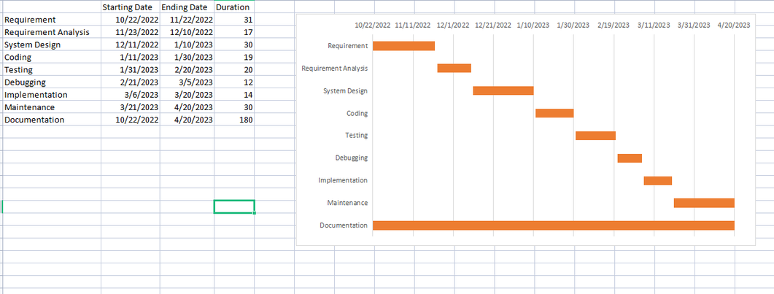
Scheduling-Gantt Chart
The diagram explains the schedule of the project where the requirement and Requirement analysis was completed in 31 and 17 days respectively. Then, system Design was completed in around 30 days collectively. Coding and testing was completed in 19 and 20 days respectively. Debugging took 12 days and afterward implementation was completed in 14 days. Side by side, process of documentation was also carried out until the completion of the project.

Slide 10
Demonstration

Slide 11

conclusion
Online Examination portal is a web application. The key concept is to minimize the amount of paper and convert all forms of documentation to digital form. It can observe that the information required can be obtained with ease and accuracy in the computerized system. The user with minimum knowledge about computer cab be easily able operate the system easily. The system also produces brief result required by the management.

Slide 12
Reference
Design and implementation of an online self-training system for the Computer System Platform course. Published in: Advanced Computational Intelligence (ICACI), 2012 IEEE Fifth International Conference on.
Mohammad A Sarrayrih1, Mohammed Ilyas (2013),”Challenges of Online Exam, Performances and Problems for Online University Examination”.
F. Andrew, Darren Pullen and Colleen Harper (2009). “Case study of a computer based examination system” Australian Journal of Educational Technology, 25(4), 509- 523.10, page 125-135.

Slide 13


Slide 14


